Slide 1

BIOTECHNOLOGY
Presented By: Guided By:
G.Harshitha Dr. P.Chandra Shaker
2203A52025 Reddy
B-31 Prof. of CSE
SR University
Gene Editing in Healthcare: Transforming Modern Medicine

Slide 2

Introduction to Biotechnology
Definition: Biotechnology is the use of biological processes, organisms, or systems to manufacture products intended to improve the quality of human life.
Purpose: Addressing genetic disorders, enhancing treatment efficacy, and personalizing medicine.
Key Tools: CRISPR-Cas9, TALENs, and Zinc Finger Nucleases.

Slide 3
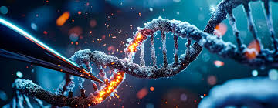
Current State of Biotechnology
1.Treating Genetic Disorders
Monogenic Disorders: Diseases caused by mutations in a single gene.
Example:
Sickle Cell Anemia: Replacing faulty hemoglobin gene using CRISPR.
Cystic Fibrosis: Correcting CFTR gene mutations.
Process:
Extraction of target cells (e.g., bone marrow).
Editing in the lab using CRISPR.
Reimplantation into the patient.

Slide 4
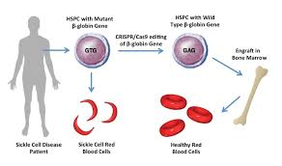
Cancer Therapy
Immunotherapy:
CAR-T Cell Therapy: Engineering T-cells to target cancer cells.
Example: Successful treatment in leukemia and lymphoma.
Resistance Mechanisms:
Using gene editing to disrupt genes in cancer cells that confer drug resistance.

Slide 5
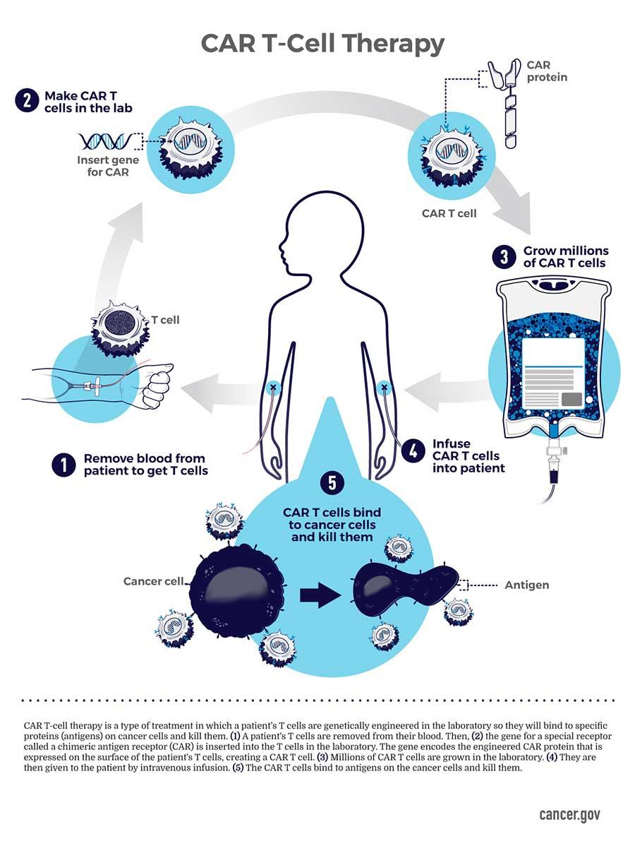
Rare and Incurable Diseases
Huntington’s Disease: Reducing harmful proteins by silencing specific genes.
Duchenne Muscular Dystrophy (DMD): Restoring dystrophin protein production through exon skipping

Slide 6
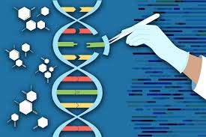
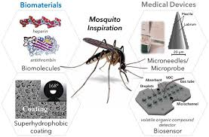
Infectious Disease Treatments
HIV:
Targeting and removing HIV DNA integrated into the host genome.
Example: Excision BioTherapeutics ongoing trials.
Malaria:
Genetically engineering mosquito populations to prevent disease transmission.

Slide 7
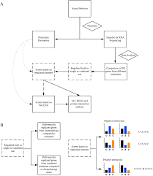
Personalized Medicine
Precision Therapies: Tailoring treatment based on an individual's genetic profile.
Example: Editing genes for better response to specific drugs.
Pharmacogenomics: Optimizing drug dosages by understanding gene-drug interactions.

Slide 8
Regenerative Medicine
Stem Cell Therapy: Correcting genetic defects in induced pluripotent stem cells (iPSCs).
Organ Repair and Transplants:
Editing donor organs to minimize rejection.
Growing organs using 3D bioprinting with gene-edited cells.

Slide 9
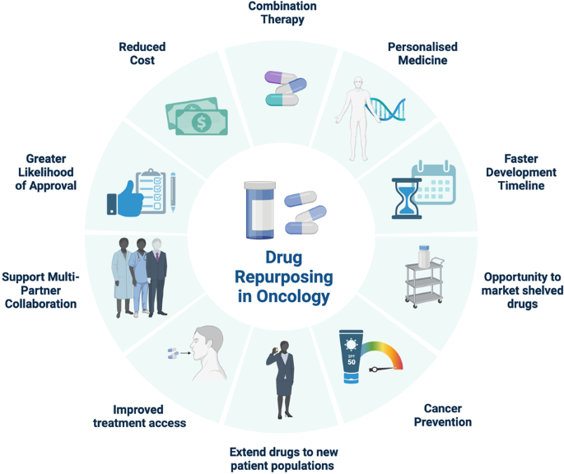
Key Advantages in Healthcare
Cures previously untreatable conditions.
Minimizes long-term healthcare costs.
Reduces dependency on lifelong treatments.

Slide 10

Challenges and Ethical Considerations
Potential off-target edits causing side effects.
Accessibility and affordability for patients in low-income regions.
Societal concerns around misuse, e.g., enhancing human traits.

Slide 11

Conclusion
Gene editing is revolutionizing healthcare by providing curative solutions for genetic and complex diseases. However, robust ethical guidelines and equitable access are crucial to ensure its benefits are universally realized.

Slide 12

Thank You

